Slide 1

Florida’s Financial Disclosure Requirements
Steven J. Zuilkowski
Staff Attorney
Kimberly R. Holmes
Financial Disclosure
Program Specialist

Slide 2

We will cover:
What is financial disclosure
How to fill out the forms
Common mistakes
How to amend a filing
Late Filing: Fines & Collections
Recent changes in the law
Questions

Slide 3
The purpose of financial disclosure
Reminds public officials of financial interests that may conflict with their duties
Citizens can monitor potential conflicts
Deters officials from actions that might cause a conflict
Instills public confidence in government

Slide 4
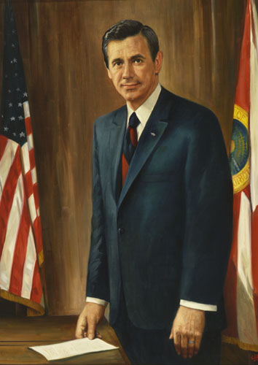
The Sunshine Amendment
Legislature rejected Gov. Askew’s call for ethics reforms
1976: Gov. Askew spearheads successful ballot initiative to create a constitutional Sunshine Amendment
“A public office is a public trust.”
Created Commission on Ethics
Required financial disclosure for public officials
Gov. Reubin Askew

Slide 5
Who files financial disclosure?
Form 6 Filers (2,500+ filers)
All constitutional officers
Candidates for constitutional offices
Form 1 Filers (35,000+ filers)
State Officers
Specified State Employees
Local Officers
See Art. II, Section 8(a), Fl. Const.
and Section 112.3144, Florida Statutes.
See Section 112.3145(1), Florida Statutes.

Slide 6
When to file financial disclosure
Form 6 Filers
By July 1 if they’re in the position on 12/31 of previous year
Within 60 days of termination
Form 1 Filers
By July 1 if they’re in the position on 12/31 of previous year
Within 60 days of termination
Within 30 days of start date

Slide 7
Creation of the Annual Filing List
The Commission is charged with the creation of the annual filing list
Each agency has a coordinator who informs the Commission who should be on the list
~1,700 coordinators
Form 6 & state-level Form 1 filers: Commission on Ethics mails forms to the filers
Local Form 1 filers: Supervisor of Elections mails forms to the filers

Slide 8
The Role of the Coordinators
Provides names/addresses of filers
Reminds newly hired/appointed filers to file Form 1 within 30 days of their start date
Reminds terminating officers/employees to file Form 1F or 6F within 60 days (more on Form 1F/6F later)
Helps to contact filers who have not filed their forms

Slide 9
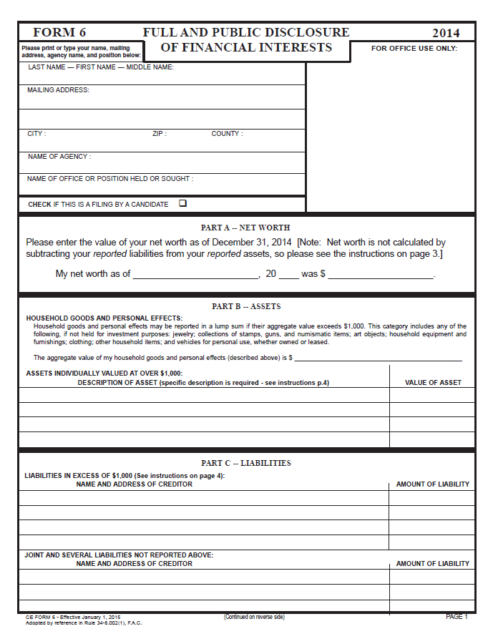
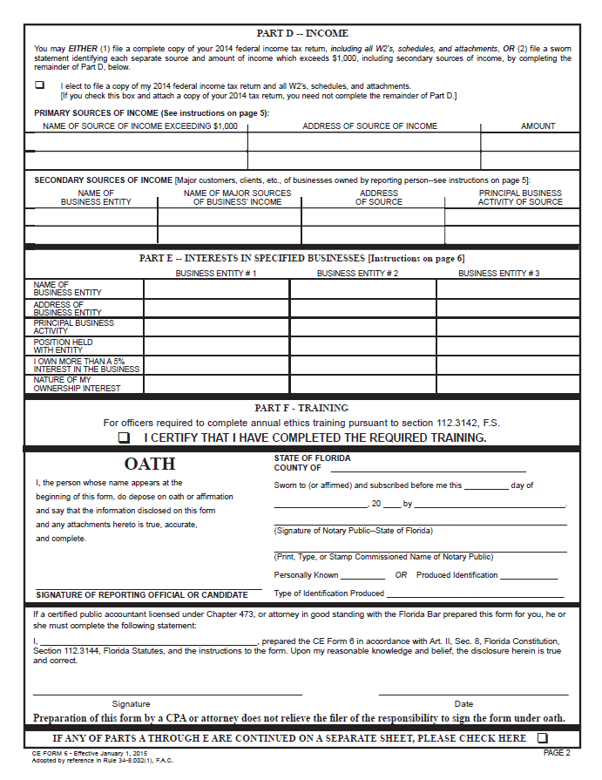
Form 6: Section by Section

Slide 10
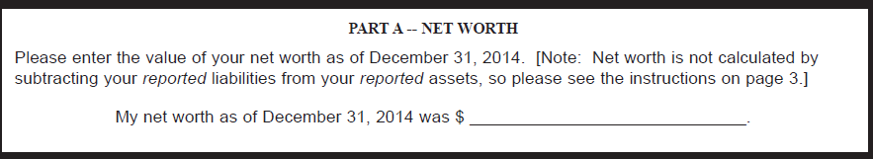
Form 6: Net Worth
Correct Calculation: ALL assets minus ALL liabilities
(this may require scrap paper)
Incorrect : reported assets minus reported liabilities
Snapshot of net worth as of December 31, 2014

Slide 11
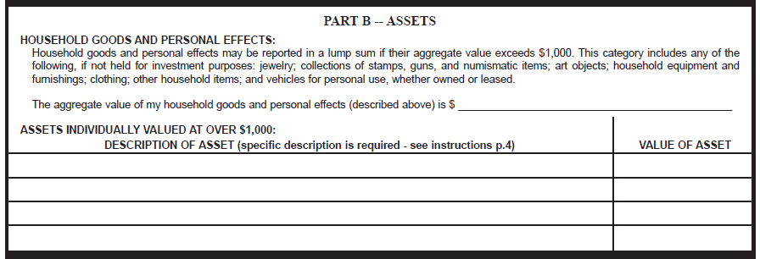

Form 6: Assets
$12,000
Bank Accounts at Bank of America $8,854
325 John Knox Road, Tallahassee, FL $300,000
Facebook Stock $2,200
Delaware Emerging Markets Mutual Fund $1,100
An asset is anything that can be sold to settle debts
List description and value of all assets over $1,000
Most common: bank accounts, real property, stock

Slide 12
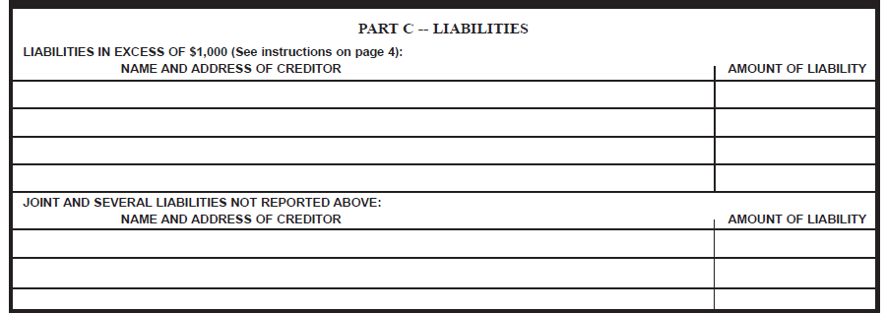
Form 6: Liabilities
U.S. Department of Education $16,978
400 Maryland Ave., SW, Washington D.C.
Wells Fargo Home Mortgage Co. $181,456
P.O. Box 10335, Des Moines, IA
List all liabilities over $1,000
Exclusions listed in form instructions
Most Common: mortgages and student Loans

Slide 13
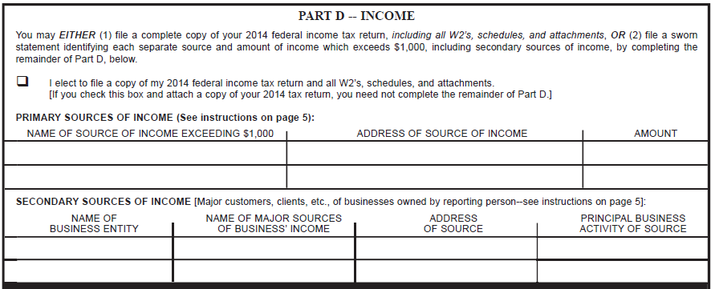
Form 6: Income
State of Florida 325 John Knox Rd. $45,000
Yum! Brands, Inc. 1900 Col. Sanders Lane $15,000
N/A
Primary Sources: gross income to the filer, such as job compensation (e.g., public salary) & capital gains
Secondary Sources: list major clients and customers of businesses of which you own more than 5 percent

Slide 14
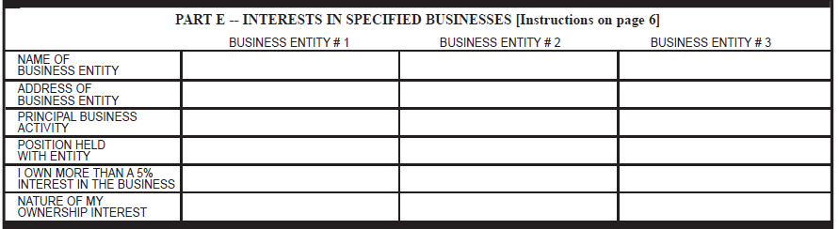
Form 6: Interests in Specified Businesses
N/A
List ownership stake in the industry types specified in the instructions
Common Mistake: Do not list businesses that are not of the specified industry types

Slide 15


Form 6: Training
Constitutional and Municipal Officers must complete 4 hours of ethics training each calendar year.
Public officials assuming a new office/term before 3/31 must complete the training before 12/31 of that year

Slide 16
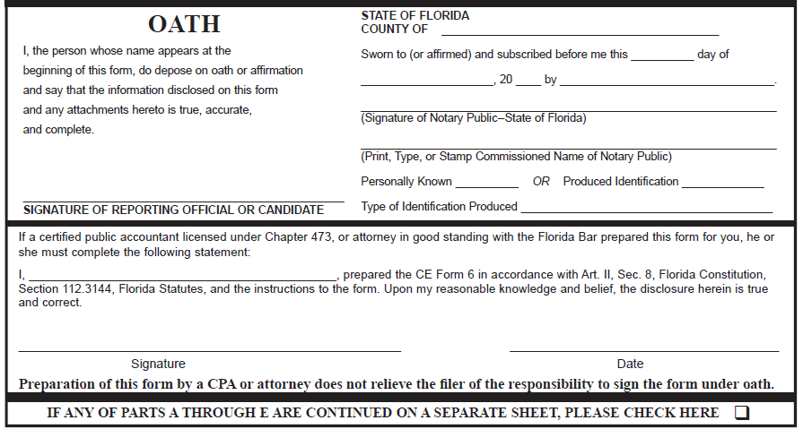
Form 6: Finishing Up

Slide 17
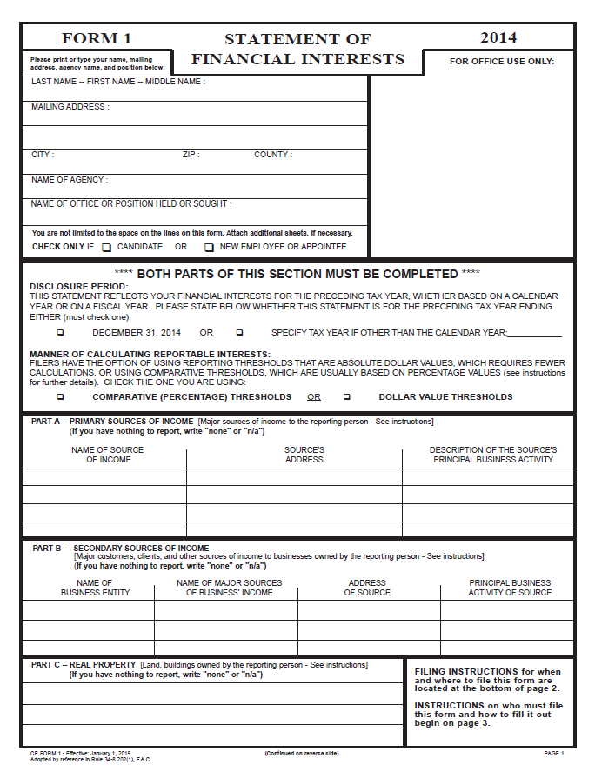
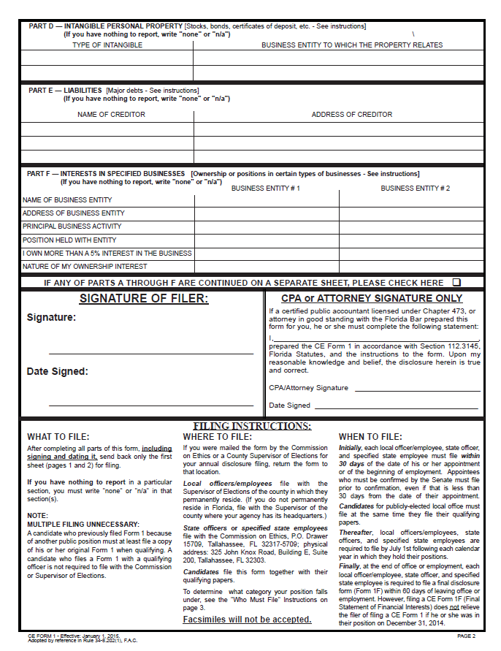
Form 1: Section by Section

Slide 18
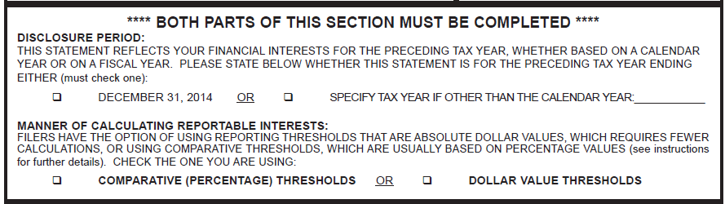
Form 1: Filing Options
Two Thresholds: Dollar Value & Comparative (Percentage)
Each threshold has its own set of instructions on the form
The filer must choose one threshold to use throughout
Common Mistake: Do not forget to check the box

Slide 19
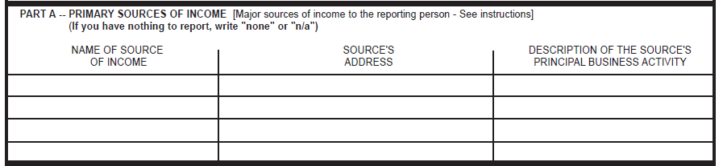
Form 1: Primary Sources of Income
Report sources of gross income to the filer exceeding threshold chosen
Dollar Value Threshold: $2,500
Do not report income amounts
Do not report public salary

Slide 20
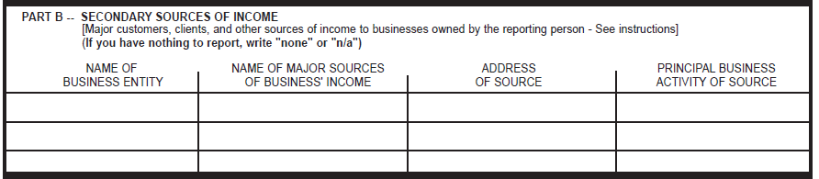
Form 1: Secondary Sources of Income
Dollar Value Threshold: List major clients and customers of businesses of which you own more than 5%
Common Mistake: do not list “second jobs”
Do not list dollar amounts

Slide 21
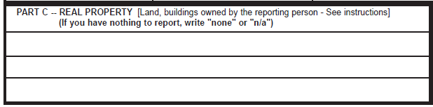
Form 1: Real Property
List property where ownership is greater than 5%
Only Florida properties are reportable
Residence(s) and vacation home(s) are not reportable
Most Common: rentals, commercial property, investment properties, vacant lots
Do not list property value

Slide 22
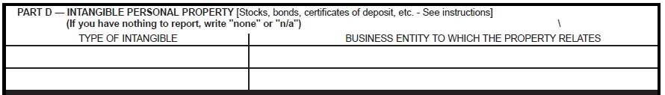
Form 1: Intangible Personal Property
Dollar Value Threshold: $10,000
Do not list dollar amounts
Most Common: bank accounts, stock

Slide 23
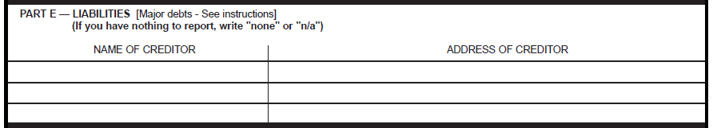
Form 1: Liabilities
Dollar Value Threshold: $10,000
Exclusions listed in form instructions
Do not list dollar amounts

Slide 24
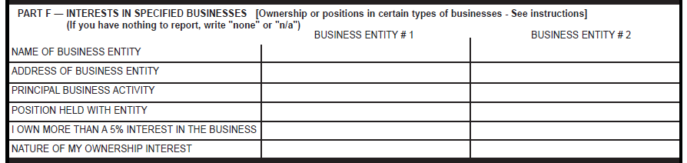
Form 1: Interests in Specified Businesses
List ownership stake in the industry types specified in the instructions
Common Mistake: Do not list businesses that are not of the specified industry types

Slide 25
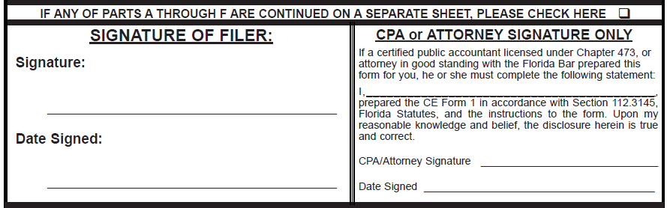
Form 1: Finishing Up

Slide 26
Common Disclosure Issues
How to Disclose IRAs, 401(k)s, Investment Accounts, and FRS Investment Plan
Do not disclose the entire investment vehicle
Instead, disclose individual investment products within the vehicle that meet the applicable threshold
See CEO 11-11 & CEO 12-10.

Slide 27
Example: Disclosing an IRA on Form 6
SAMPLE IRA CONTAINS
Facebook Stock | $11,000
XYZ Mutual Fund | $2,000
G.M. Stock | $500
IRA TOTAL | $13,500
Disclose individual products
Form 6 Threshold for Assets is $1,000
Facebook stock $11,000
XYZ Mutual Fund $2,000

Slide 28
Example: Disclosing an IRA on Form 1
SAMPLE IRA CONTAINS
Facebook Stock | $11,000
XYZ Mutual Fund | $2,000
G.M. Stock | $500
IRA TOTAL | $13,500
Disclose individual products
Form 1 Threshold for Intangible Assets is $10,000
Do not report dollar amounts
Stock Facebook

Slide 29
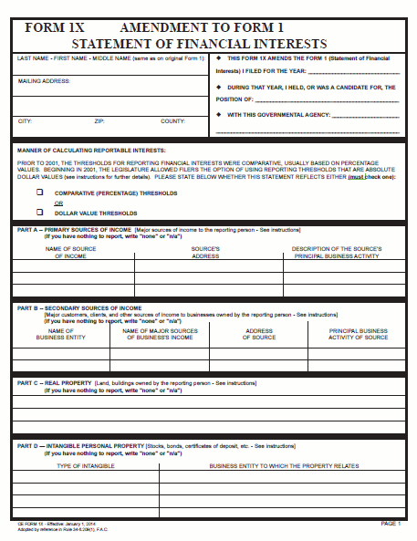
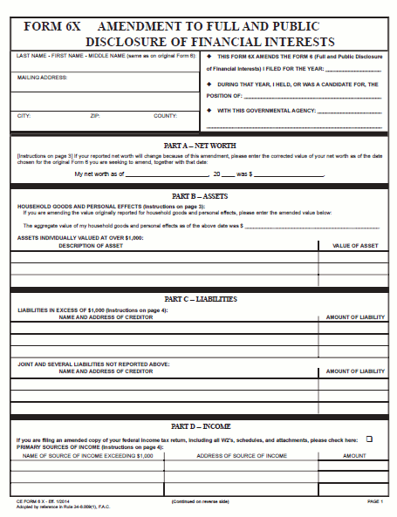
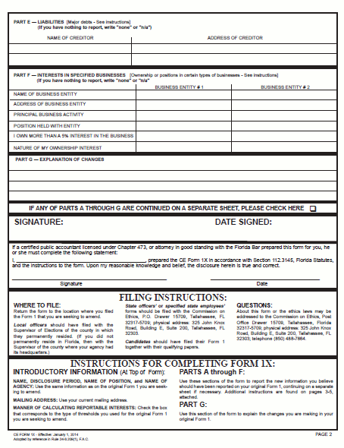
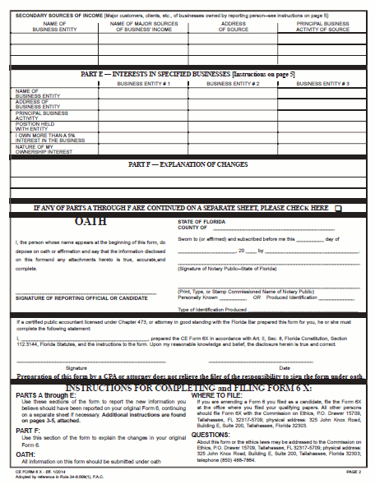
How do I fix a mistake or omission?
Form 1X
Form 6X

Slide 30
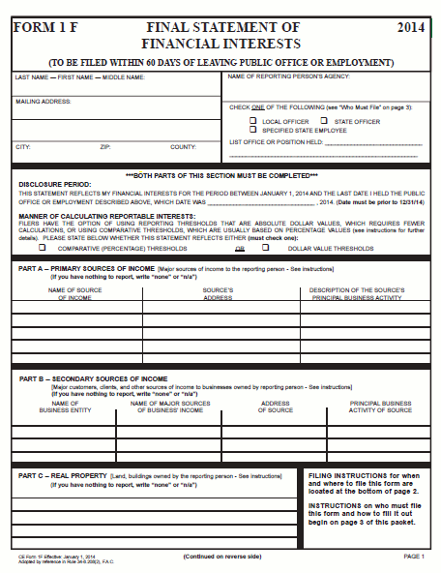
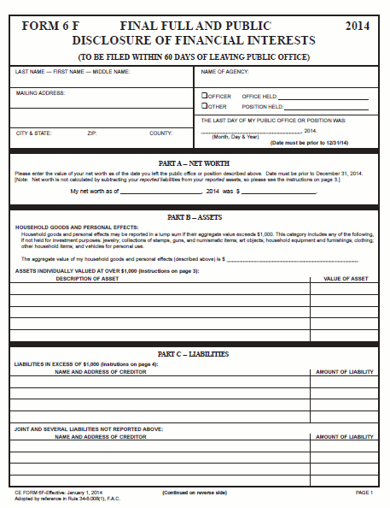
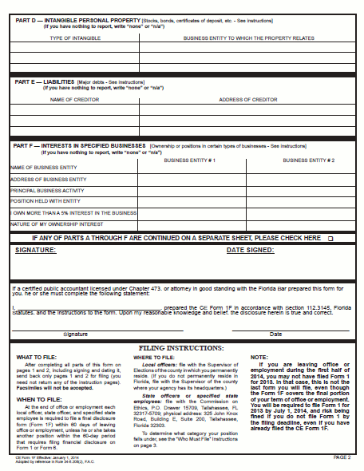
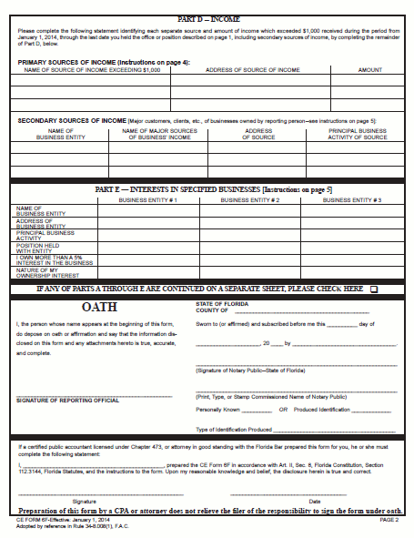
What if I leave public office/employment?
Form 1F
Form 6F

Slide 31
Additional Forms for Reporting Individuals
Gifts Law
  Section 112.3148, Florida Statutes
  Form 9, Quarterly Gift Disclosure
  Form 10, Annual Disclosure of Gifts from Governmental Entities and Direct-Support Organizations and Honorarium Event Related Expenses
Client Disclosure
  Section 112.3145(5), Florida Statutes
  Form 2, Quarterly Client Disclosure

Slide 32
Late Filers
Forms are due July 1 every year
Penalty-Free Grace Period through September 1
After Sept. 1, fines of $25/day for up to 60 days ($1,500)
Fine can be appealed if “unusual circumstances” outside the filer’s control prevented a timely filing
Collection of fines
  Payment agreements with Commission on Ethics
  Salary withholding of compensated public officials
  Collection Agency
  Garnishment
Statute of Limitations for collection of fines is 20 years

Slide 33
Change in the Law Effective 7/1/14
If a public official or employee fails or refuses to file a financial disclosure form and receives the maximum fine ($1,500)
the Commission shall automatically investigate and conduct a public hearing
to determine whether the person’s failure to file was willful
For Form 6, see Section 112.3144(6), Florida Statutes.
For Form 1, see Section 112.3145(8)(c), Florida Statutes.

Slide 34
Change in the Law Effective 7/1/14 (cont.)
If the failure to file is found to be willful
the Commission must enter an order
recommending that the officer/employee be removed from his/her position
For Form 6, see Section 112.3144(6), Florida Statutes.
For Form 1, see Section 112.3145(8)(c), Florida Statutes.

Slide 35

If you have questions…
Please do not hesitate to contact us
Telephone: (850) 488-7864
Email: disclosure@leg.state.fl.us

